Slide 1
Business Innovation & Product Development
ENCORE, Norway September 2017

Slide 2
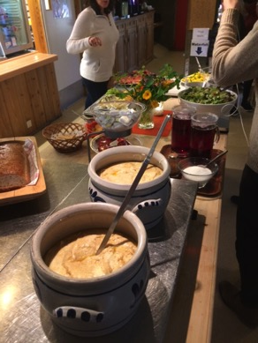
CONTENTS PAGE
What is Product Development? 3
Introduction: The Study Group 4
Background: Telemark Region 5
Fruit Village Gvarv 6
Product development: Beveroya Camping 7
Comment 8
Business Innovation: Hardangervidda National Park Centre 9
Comment 10
Market Penetration: Evju Bygdetun Sauherad 11
Comment 12
Diversification: Lindheim Brewery 13
Comment 14
Market Penetration: Øvre Verket 15
Comment 16
Comparison: Eplefest 17
Apple Day 18
Academic Perspective 19
Conclusion 20

Slide 3
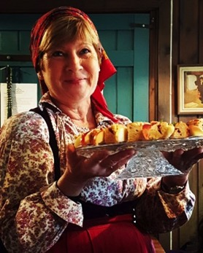
What is Product Development?
Product development is essential to keep destinations and tourism products fresh, current and competitive. There are essentially four business innovation options for product development:
Market penetration: selling existing products or services to existing markets, possibly increasing the quality of offering, being more effective or increasing marketing.
Market development: extending existing products or services to new markets. This is often necessary when a market becomes saturated or changes its habits, This may mean promoting in other geographic areas or different market segments.
Product development: developing new products or services for existing markets. This could mean developing something completely new or combining services to create a new angle for an existing market whose needs and wants are already well known.
Diversification: this is rarer because it means moving away from core competencies and strengths, and can be expensive. An example would be a farmer who diversifies from arable farming into holiday accommodation - a new service for a new market.

Slide 4
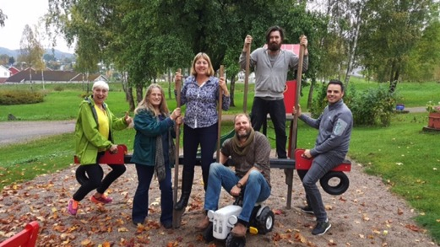
The Study Visit
In September 2017, a group of 20 tourism and food professionals visited Norway. Our focus was on food and rural tourism, exploring sense of place and Nordic culture
We visited the area of Midt-Telemark, Norway from 22nd – 29th September, and had the opportunity to meet with representatives from the University College of Southeast Norway and many local businesses.
We saw numerous examples of business innovation and product development, and this report is a collaborative effort from six delegates (pictured left) who were considering this subject.
Study Group left toto right : Sheila Gilmore, Virginia Sumsion, Susan Briggs, Jared Bowers, Jack Harris, Stuart Fraser.

Slide 5
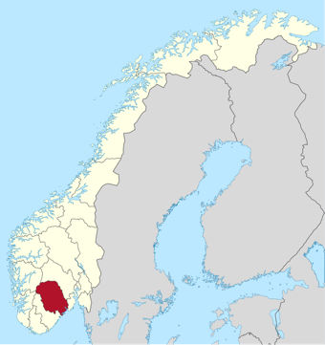
Background on Telemark Tourism
According to Visit Bø, visitors to Telemark are primarily domestic. In Summer 98% of visitors are from within Norway, the majority of them travelling with their family, attracted by the seasonal opening of Bø Sommarland water park.
Winter visitors come to ski, with a higher proportion of overseas visitors from Denmark, Germany and the Netherlands.
Telemark’s visitors are attracted by the Telemark Canal. The area offers Norway in miniature, from coast to mountain.

Slide 6
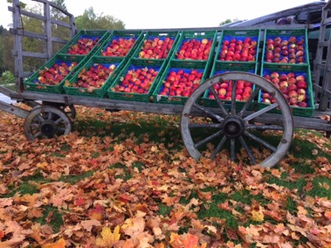
Background on Fruit Village Gvarv
We visited the Fruit Village Gvarv, which comprises around 13 food & drink producers & businesses close to Lake Norsjo & the Telemark Canal.
Evolving from a business innovation project by Visit Telemark & Innovation Norway the concept started around 2010. and there has been extensive product development, diversification and market penetration as a result
Examples include fruit producers selling fruit juice through roadside outlets, brewery and vineyard tours, & Epelfest, the annual apple festival

Slide 7
Product Development – Beveroya Camping
Beveroya Camping is located in the community of Bø. The group stayed here for three nights.
The campsite comprises basic cabins as well as newer more modern ones, in which the group stayed. These have wifi, flatscreen TV, and a fully fitted and equipped kitchen, with dishwasher, hob, microwave etc.
Cabins are clean, fresh and also have a washing machine located in the shower-room. Space within the bedrooms was very limited, with no facility to store clothing.
There is a shower facility for those camping in more basic accommodation.
We interviewed the Marketing Manager, Ottar Langasdalen.

Slide 8
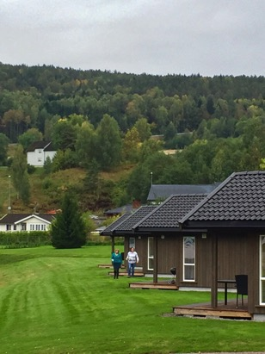
Comment - Beveroya Camping
Beveroya Camping has developed to meet demand for accommodation for construction workers.
Living areas are excellent, with good facility.
Bedroom space is limited, however, these will suit the client group for which the cabins were designed.
This accommodation is not the same market as family tourism, which would probably require greater overall internal storage, certainly for the UK market.

Slide 9
Business Innovation - Hardangervidda National Park Centre
The Hardangervidda National Park Centre is a government owned part of Europe's largest national park, Hardangervidda.
The award-winning nature and reindeer exhibition opened in 2013 with 22 interactive installations and a cinema. One of the more impressive installations includes pictures and video from a camera attached to the reindeer Bella for one year (2012), following her on the Hardangervidda plateau.
There is also a stunning viewing platform situated next to the cafe and useful information on the local area and wildlife. We interviewed Staale Rue, the centre manager and host, who advised that the centre receives approximately 12,000 visitors per annum.

Slide 10
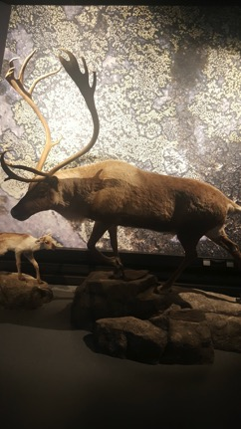
Comment – Hardangervidda National Park Visitor Centre
This was an excellent visitor centre. The exhibition was very well constructed, delivering just the right amount of information via a myriad of exceptional interactive mediums, which could be replicated in such centres within the UK.
The interactive exhibition where you can follow the reindeer Bella was informative, educational and fun. The centre has developed an innovative and useful exhibition that has potential to be more of a focal point of the tourism experience in the region.
With only 12,000 visitors, there seems to be scope to increase this figure significantly and drive more engagement with and within Norway's largest national park. Learning about the important flora and fauna, in particular the reindeer, is an essential element of visiting the national park.
Perhaps the tourism arm of the national park could engage more with local DMOs and tourism businesses to showcase the benefit of visiting such a site and really highlight its special qualities.

Slide 11
Market Penetration – Evju Bygdetun Sauherad
Evju Bygdetun Sauherad is a folk museum based on a working farm that was gifted to a foundation in the 1970s to be kept as a example of rural farming. It is run without any public funding.
The key employee we interviewed was Jorid Vale, a wonderfully enthusiastic former music teacher who also runs her own plum farm nearby. She aims to provide visitors of all kinds (tourists, students, groups, locals) with a unique and memorable experience, utilising the historical environment and artefacts as an active part of the experience.
The centre is used as a venue for events such as weddings as well as for local clubs and groups.

Slide 12
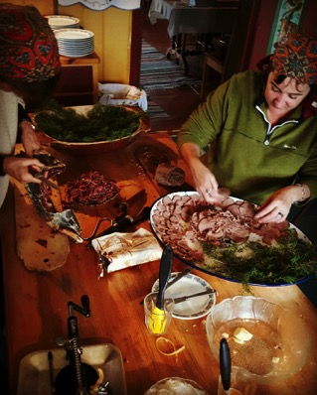
Comment - Evju Bygdetun Sauherad
Our group spent a day at the centre creating and consuming a meal using produce from the garden and the local surroundings. The resulting meal was full of flavour, colour and delight and enhanced by our knowledge of every ingredient on the plate.
Everyone was blown away by the day, which as well as the meal included singing, gardening & fish smoking. It was a unique experience for all.
The innovative ideas being put into practice around museum curatorship and the learning process were countless.
Jorid’s ability to make everyone part of the day and place, and appreciate our own contribution as much as her’s (and her colleague’s) meant that the interest taken in every item and place we came across was far greater than during a ‘normal’ museum experience. This was experiental learning at its best.

Slide 13
Diversification – Lindheim Brewery
For the past 70years, this has been a family fruit farm, growing apples, cherries (sour and sweet), raspberries and plums.
In 2013, the owners’ daughter and her husband purchased the farm (at market value).
Turnover was too small to be sustainable and support their growing family, so they decided to diversify and developed Lindheim Brewery onsite, using their own fruit to flavour the beer.
We spoke with owner Ingeborg Lindheim, and after sampling 4 of their most well known ales (all very tasty) we then had an impressive tour of the facility.

Slide 14
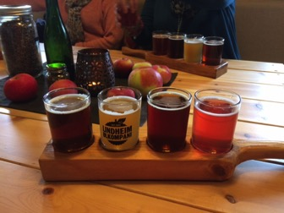
Comment – Lindheim Brewery
Lindheim are experimental with their ales using fruits from their own orchards. They didn’t just buy lactic bacteria from a brewery supply shop to create this, they use live yogurt as a starter!
Attention to detail is incredible and everything from the brewery decor to the bottle labels is steeped in history with a quirky side that left us all feeling both impressed and emotionally connected to the family and brand.
One of their first ales was named after Ingeborg’s Grandmother and her toddler daughter’s hand drawn pictures were used on other ale labels (very appropriately named 'the friendship series’). Certainly a novel way to preserve those drawings that pile up on the kitchen fridge!
Whilst we were all impressed with the scale of the operation and Ingeborg’s knowledge we were left questioning how they managed to finance both the purchase of the farm and the massive capital outlay of the brewery. We were not advised if any public funding had enabled this diversification.

Slide 15
Market Penetration - Øvre Verket
Øvre Verket, based in Ulefoss, is a form of open air museum and an important culturally historic location in the Telemark region. The museum is made up of several buildings and wooden houses that were built in the early 1800s as living quarters for workers in the Ulefoss Ironworks.
The group were were advised that man-hole covers from Ulefoss can be seen worldwide
The museum is located near the Telemark Canal, Ulefoss locks and other key historical buildings and residences.
There is also a restaurant, workshops, play area and interactive exhibits aimed at attracting visitors to this unique 'industrial age' experience.
We interviewed Jon Harald Aspheim, our voluntary tour guide for the museum village.

Slide 16
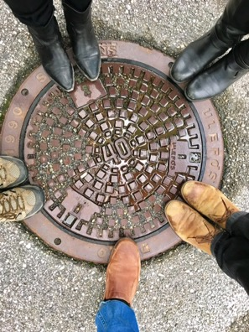
Comment - Øvre Verket
This was an interesting facility that could possibly do with greater publicity
Being based around a still functioning iron works, and with some of the houses still lived in, it was more a living history collection than a museum
The exhibits in houses could be directly related to the lives going on around them, making it more relevant for the visitor
The link to man-hole covers made it memorable for all, as these can be seen far and wide and everyone can therefore relate to them
Again, it was the enthusiasm, and passion of the guide Jon Harald that made the visit special.

Slide 17
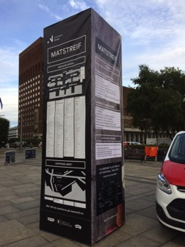
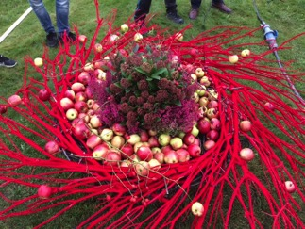
Comparison – Epelfest (Telemark) & Apple Day (UK)
Epelfest
The group visited Epelfest, the annual apple festival for the region. It was recognized that Epelfest was a more local event, with singing, and various stalls, including Asian food. The date of the event clashed with Matstreif, Norway’s big food & drink festival.
The study group felt it was a great pity there was not more local provenance from the region at Epelfest, particularly in savoury offerings. To increase footfall perhaps the date could be changed to avoid clashing with Matstreif.
Most traders at Epelfest used credit card facilites. This is not something that can be used at such events across the UK, given the variable connectivity, and the study group were envious of this!
Image from Epelfest
Promo image for Matstreif

Slide 18
Comparison – Epelfest (Telemark) & Apple Day (UK)
An example from UK: Apple Day
It may be interesting to consider the example of Apple Day & related work by the charity, Common Ground. Apple Day was created in 1990 as a celebration of apples and local distinctiveness. It has also raised awareness of the provenance of the food we eat.
Activities now take place across the UK on 21st October. These include apple tasting, pressing and juicing, baking, pruning and grafting demonstrations, printing with apples, apple sculptures, folk singing and poetry evenings.
However, it was noted by some of the study group that this event also was not publicised nationally as widely as it could be
Apple day logo

Slide 19
Academic Perspective Gudrun Helgadottir & Students
We met with Gudrun Helgadottir, who is an Icelandic academic currently working as an Associate Professor at the University of Southeast Norway.
Her field of research and teaching is cultural tourism, event management and heritage tourism. She has a special interest in visualisation in tourism and intangible heritage, in how cultural practices are seen and received in the context of tourism.
We also interviewed some of Gudrun’s second year students, studying business and tourism – Frida Klippen, Marlene Nilssen, Madelein Christanssen and Margarethe Thu. The UK has a great problem retaining and recruiting front-of-house hospitality staff, and the study group were curious to find out what had motivated the students and also where their careers in tourism might lie.
Following on from the interview with Gudrun, it is apparent that the same issues apply in Norway, with students generally aiming at managerial roles.

Slide 20
Conclusion
Many of the same issues face Telemark as in UK when it comes to recruiting and retaining staff in hospitality.
Public funding for product development and business innovation was not apparent, although the study group were informed that the Fruit Village Gvarv was developed with support from Innovation Norway
The best product development and business innovation was when the host was passionate about the subject, eg Jorid Vale, Jon Harald Aspheim, Ingeborg Lindheim and Staale Rue. It should be noted that in each case these people went the extra mile to ensure an amazing experience.
The food & drink offering did not always reflect the true quality of local provenance.
Accommodation was variable throughout our stay (also at Norsjø Hotel). The study group experienced different levels of quality, possibly due to ongoing refurbishment.
Singing for Sunshine at Evju Bygdetun Sauherad
The Study Group would like to thank Erasmus, Tourism Angles (UK) and the host businesses for their hospitality and support during this visit.
Particular thanks to Karen Donnelly and Jackie Ellis for the opportunities presented.

